Slide 1
Non Recursive Predictive Parsing
Lecture 10

Slide 2
Topics Covered in Lecture 9

Slide 3
A general form of top-down parsing where backtracking may be involved.
Why does Recursive Descent Parser fail at particular conditions ?
Predictive Parsing is a special case of recursive descent parsing that needs no back tracking
Transition Diagrams as a plan for predictive parsing
Optimizing Transition Diagrams

Slide 4
Non Recursive Predictive Parser/ LL(k) Parser
It is possible to build a non recursive predictive parser by maintaining a stack explicitly
Key problem with predictive parsing – determining the production to be applied for a non terminal

Slide 5
Table-driven parsing vs. recursive descent parsing
Recursive descent: every production is a procedure. Implicit stack holds active procedures corresponding to pending non-terminals.
Table-driven parser: recursion simulated with explicit stack.

Slide 6
Predictive Parsing using a Parsing Table
Model
a
+
b
$
Input buffer
stack
X
Predictive Parser
Output stream
Y
Z
$
Parsing table M

Slide 7
Non Recursive Predictive Parser/ LL(k) Parser
Non recursive parser looks up the production to be applied by looking up a parsing table
Input buffer contains the string to be parsed; $ - end of input marker
Stack contains a sequence of grammar symbols with $ on the bottom, indicating the bottom of stack
Initially, stack contains the start symbol of the grammar on the top of $
Parsing table is a two-dimentional array M[A,a] where:
  A → Non terminal
  a → Terminal or the symbol $

Slide 8
Non Recursive Predictive Parser/ LL(k) Parser
For a grammar to be suitable for predictive parsing, it has to be an LL(k) grammar
The two LL stands for Left-to-Right scan of input, Left most derivation
K: stands for number of lookahead tokens of input
LL(1) property allows the parser to make a correct choice of picking alternative (production rule) with a lookahead of exactly ONE symbol
To determine whether a particular grammar is LL(1), a Parsing Table has to be constructed
This is error prone and tedious process for large grammar but can be automated

Slide 9
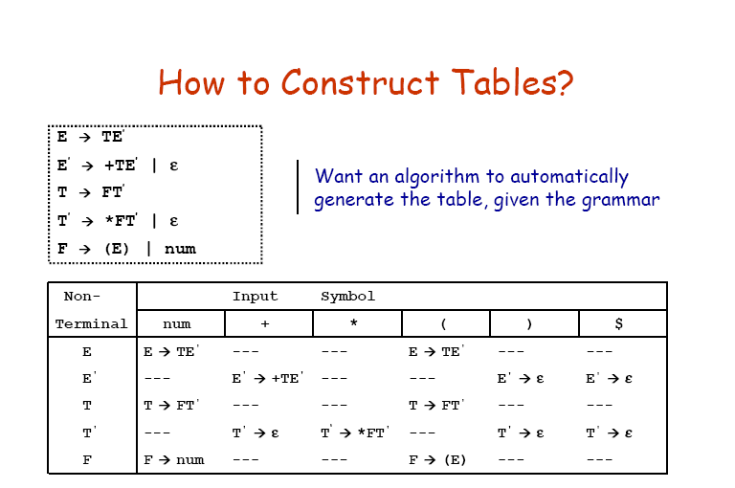

Slide 10
How to construct Table?
To determine the FIRST and FOLLOW sets of each of the symbols defined or used in the grammar
These sets allow us to fill in the entries of a predictive parsing table for G
FIRST sets:
  FIRST (α) is defined to be the set of terminal symbols that can appear on the left hand side of the strings derived from α
FOLLOW sets:
  FOLLOW (α) is defined to be the set of terminal symbols that can appear immediately to the right of α in a sentential form

Slide 11
Computing FIRST Sets
For terminal symbol α , FIRST (α) = {α}
If α → ε, add ε to FIRST(α)
For all productions, α → k₁k₂…k_{n}
  Add FIRST(K₁) – {ε} to FIRST(α), stop if ε not a member of FIRST(k₁)
  Add FIRST(K₂) – {ε} to FIRST(α), stop if ε not a member of FIRST(k₂)
  and so on.

Slide 12
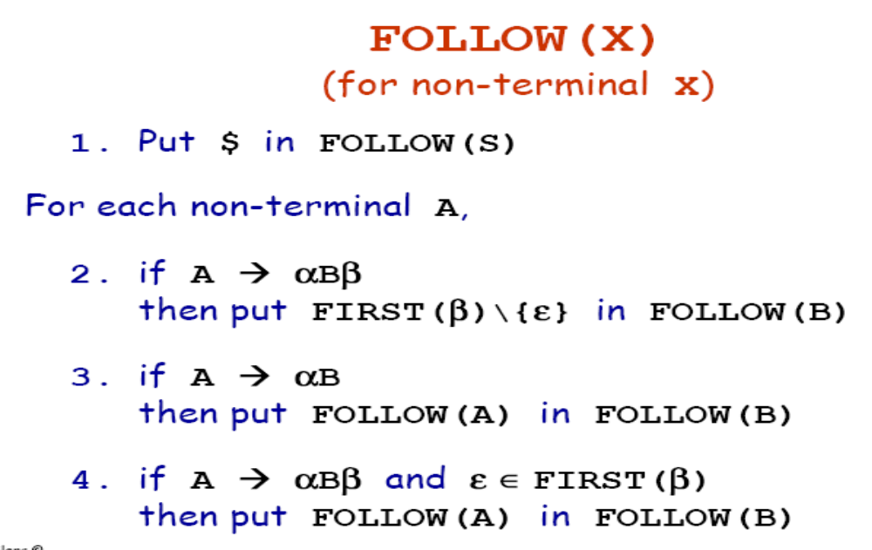
Computing FOLLOW Sets

Slide 13
Learn by Example

Slide 14
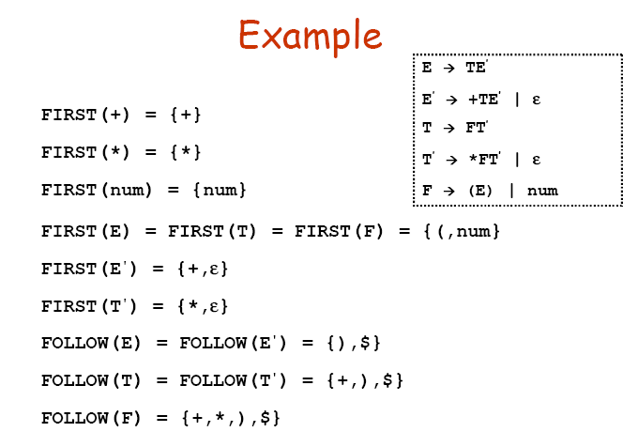

Slide 15
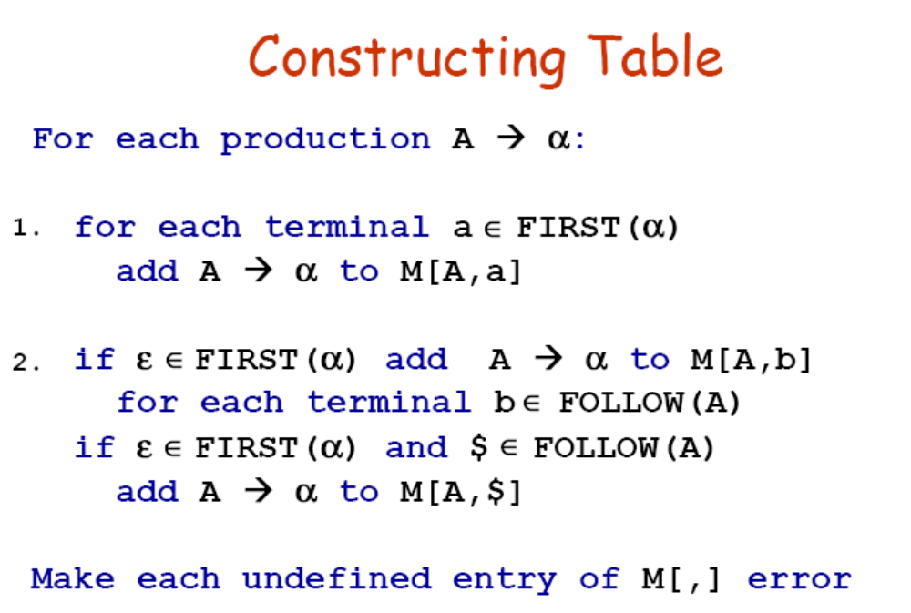

Slide 17
Example
NT/T | + | * | ( | ) | ID | $
E
E’
T
T’
F
Production | Predict
1: E → T E’ | {(,id}
2: E’ → + T E’ | {+}
3: E’ → ε | {$,)}
4: T → F T’ | {(,id}
5: T’ → * F T’ | {*}
6: T’ → ε | {+,$,)}
7: F → id | {id}
8: F → ( E ) | {(}

Slide 18
Production | Predict
1: E → T E’ | {(,id}
2: E’ → + T E’ | {+}
3: E’ → ε | {$,)}
4: T → F T’ | {(,id}
5: T’ → * F T’ | {*}
6: T’ → ε | {+,$,)}
7: F → id | {id}
8: F → ( E ) | {(}
NT/T | + | * | ( | ) | ID | $
E |  |  | 1 |  | 1
E’ | 2 |  |  | 3 |  | 3
T |  |  | 4 |  | 4
T’ | 6 | 5 |  | 6 |  | 6
F |  |  | 8 |  | 7
Reference:
http://hackingoff.com/compilers/predict-first-follow-set

Slide 19
Parsing Algorithm
Parsing table can be used to construct an efficient Top-Down parser
Parser maintains a stack of symbols, initialized with $ at the bottom and S at the top
Parser reads symbols from the input buffer one at a time
Parser picks a production by looking at the current input symbol a and the symbol X at the top of stack

Slide 20
Parsing Algorithm
Parser behaves as follows:
  If (X = a = $), parser halts and announces successful completion
  If (X = a # $), the parser pops X off the stack and advances the input pointer to the next input pointer
  If X is non-terminal, the program consults entry M[X,a] of parsing table M
    If the entry is a production M[X,a]= {X → UVW},
    then parser replaces X on top of stack by WVU (with U on top)
    If the entry in the table (M) is empty, parser calls an error recovery routine

Slide 21
Stack | Input | Action
$E | a+b*c$ | E → T E’
NT/T | + | * | ( | ) | ID | $
E |  |  | 1 |  | 1
E’ | 2 |  |  | 3 |  | 3
T |  |  | 4 |  | 4
T’ | 6 | 5 |  | 6 |  | 6
F |  |  | 8 |  | 7
_{Assume E is the start symbol}

Slide 22
Stack | Input | Action
$E | a+b*c$ | E → T E’
$E’T | a+b*c$ | T → F T’
NT/T | + | * | ( | ) | ID | $
E |  |  | 1 |  | 1
E’ | 2 |  |  | 3 |  | 3
T |  |  | 4 |  | 4
T’ | 6 | 5 |  | 6 |  | 6
F |  |  | 8 |  | 7

Slide 23
Stack | Input | Action
$E | a+b*c$ | E → T E’
$E’T | a+b*c$ | T → F T’
$E’T’F | a+b*c$ | F → id
NT/T | + | * | ( | ) | ID | $
E |  |  | 1 |  | 1
E’ | 2 |  |  | 3 |  | 3
T |  |  | 4 |  | 4
T’ | 6 | 5 |  | 6 |  | 6
F |  |  | 8 |  | 7

Slide 24
Stack | Input | Action
$E | a+b*c$ | E → T E’
$E’T | a+b*c$ | T → F T’
$E’T’F | a+b*c$ | F → id
$E’T’id | a+b*c$ | match
NT/T | + | * | ( | ) | ID | $
E |  |  | 1 |  | 1
E’ | 2 |  |  | 3 |  | 3
T |  |  | 4 |  | 4
T’ | 6 | 5 |  | 6 |  | 6
F |  |  | 8 |  | 7

Slide 25
Stack | Input | Action
$E | a+b*c$ | E → T E’
$E’T | a+b*c$ | T → F T’
$E’T’F | a+b*c$ | F → id
$E’T’id | a+b*c$ | match
$E’T’ | +b*c$ | T’ → ε
NT/T | + | * | ( | ) | ID | $
E |  |  | 1 |  | 1
E’ | 2 |  |  | 3 |  | 3
T |  |  | 4 |  | 4
T’ | 6 | 5 |  | 6 |  | 6
F |  |  | 8 |  | 7

Slide 26
Stack | Input | Action
$E | a+b*c$ | E → T E’
$E’T | a+b*c$ | T → F T’
$E’T’F | a+b*c$ | F → id
$E’T’id | a+b*c$ | match
$E’T’ | +b*c$ | T’ → ε
$E’ | +b*c$ | E’ → + T E’
NT/T | + | * | ( | ) | ID | $
E |  |  | 1 |  | 1
E’ | 2 |  |  | 3 |  | 3
T |  |  | 4 |  | 4
T’ | 6 | 5 |  | 6 |  | 6
F |  |  | 8 |  | 7

Slide 27
Stack | Input | Action
$E | a+b*c$ | E → T E’
$E’T | a+b*c$ | T → F T’
$E’T’F | a+b*c$ | F → id
$E’T’id | a+b*c$ | match
$E’T’ | +b*c$ | T’ → ε
$E’ | +b*c$ | E’ → + T E’
$E’ T + | +b*c$ | match
NT/T | + | * | ( | ) | ID | $
E |  |  | 1 |  | 1
E’ | 2 |  |  | 3 |  | 3
T |  |  | 4 |  | 4
T’ | 6 | 5 |  | 6 |  | 6
F |  |  | 8 |  | 7

Slide 28
Stack | Input | Action
$E | a+b*c$ | E → T E’
$E’T | a+b*c$ | T → F T’
$E’T’F | a+b*c$ | F → id
$E’T’id | a+b*c$ | match
$E’T’ | +b*c$ | T’ → ε
$E’ | +b*c$ | E’ → + T E’
$E’ T + | +b*c$ | match
$E’ T | b*c$ | T → F T’
NT/T | + | * | ( | ) | ID | $
E |  |  | 1 |  | 1
E’ | 2 |  |  | 3 |  | 3
T |  |  | 4 |  | 4
T’ | 6 | 5 |  | 6 |  | 6
F |  |  | 8 |  | 7

Slide 29
Stack | Input | Action
$E | a+b*c$ | E → T E’
$E’T | a+b*c$ | T → F T’
$E’T’F | a+b*c$ | F → id
$E’T’id | a+b*c$ | match
$E’T’ | +b*c$ | T’ → ε
$E’ | +b*c$ | E’ → + T E’
$E’ T + | +b*c$ | match
$E’ T | b*c$ | T → F T’
$E’T’F | b*c$ | F → id
NT/T | + | * | ( | ) | ID | $
E |  |  | 1 |  | 1
E’ | 2 |  |  | 3 |  | 3
T |  |  | 4 |  | 4
T’ | 6 | 5 |  | 6 |  | 6
F |  |  | 8 |  | 7

Slide 30
Stack | Input | Action
$E | a+b*c$ | E → T E’
$E’T | a+b*c$ | T → F T’
$E’T’F | a+b*c$ | F → id
$E’T’id | a+b*c$ | match
$E’T’ | +b*c$ | T’ → ε
$E’ | +b*c$ | E’ → + T E’
$E’ T + | +b*c$ | match
$E’ T | b*c$ | T → F T’
$E’T’F | b*c$ | F → id
$E’T id | b*c$ | match
NT/T | + | * | ( | ) | ID | $
E |  |  | 1 |  | 1
E’ | 2 |  |  | 3 |  | 3
T |  |  | 4 |  | 4
T’ | 6 | 5 |  | 6 |  | 6
F |  |  | 8 |  | 7

Slide 31
Parsing a + b * c
Stack | Input | Action
$E | a+b*c$ | E → T E’
$E’T |  | T → F T’
$E’T’F |  | F → id
$E’T’id |  | match
$E’T’ | +b*c$ | T’ → ε
$E’ |  | E’ → + T E’
$E’T+ |  | match
$E’T | b*c$ | T → F T’
Stack | Input | Action
$E’T’F |  | F → id
$E’T’id |  | match
$E’T’ | *c$ | T’ → * F T’
$E’T’F* |  | match
$E’T’F | c$ | F → id
$E’T’id |  | match
$E’T’ | $ | T’ → ε
$E’ |  | E’ → ε
$ |  | accept

Slide 32
Learn by Doing
Parse Trace of (z + q) * x + w * y

Slide 33
Parse Trace of (z + q) * x + w * y
Stack | Input | Output
$E | ( id + id ) * id + id * id $
$E’T | ( id + id ) * id + id * id $ | E→T E’
$E’T’F | ( id + id ) * id + id * id $ | T→F T’
$E’T’)E( | ( id + id ) * id + id * id $ | F→( E )
$E’T’)E | id + id ) * id + id * id $
$E’T’)E’T | id + id ) * id + id * id $ | E→T E’
$E’T’)E’T’F | id + id ) * id + id * id $ | T→F T’
$E’T’)E’T’id | id + id ) * id + id * id $ | F→id
$E’T’)E’T’ | + id ) * id + id * id $
$E’T’)E’ | + id ) * id + id * id $ | T’→ε

Slide 34
Learn by Doing
Construct a parsing table for the following grammar
S → iEtSS’ | a
S’ → eS |Є
E → b

Slide 35
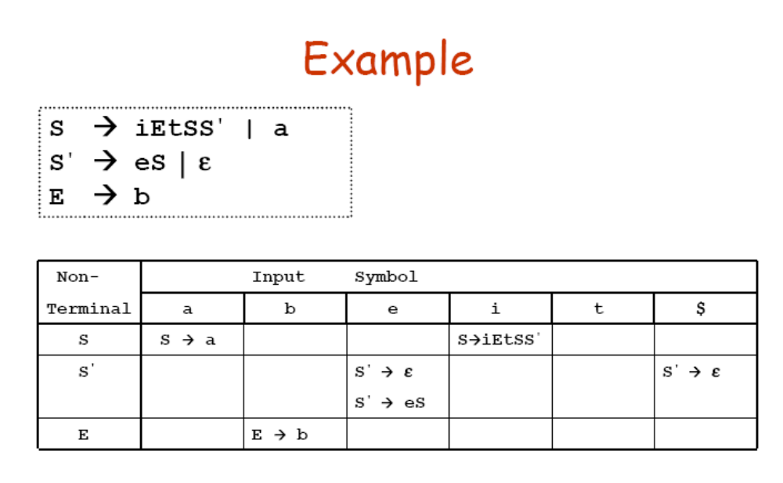

Slide 36
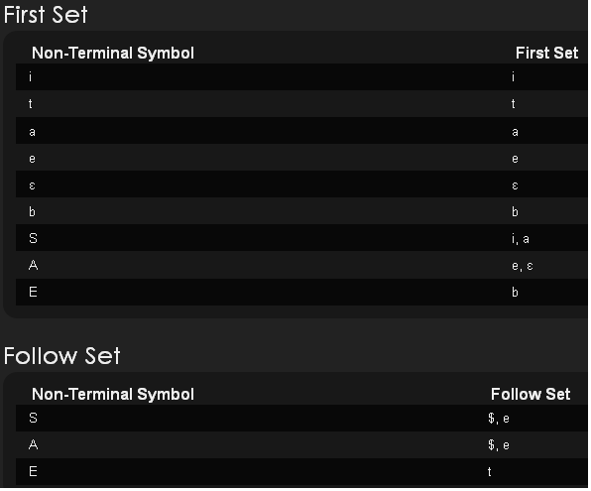

Slide 37
Quiz
Consider the following grammar:
S → (A)
A → CB
B → ;A | ε
C → x | S
Construct the Parsing Table and show the working of LL(1) parser for the following input:
(x;((x;x)))

